Slide 1
Analysing popularity of cultural sights and places of Budapest
Zsolt Nagy

Slide 2

Business problem/Introduction (fictional)
Commissioned by: Central Government of Capital City, Budapest
Background:
investigation of popularity of cultural sights in Budapest
local government could better allocate development resources
Detailed plans can be set:
Identifying the most frequently visited categories/areas/places for maintaining high quality services, like roads, info points, the condition of buildings, etc.
Identifying frequently visited places for rising awareness of tourists and locals with media campaigns to raise visits even further
Understanding the reasons why certain places are rarely visited
Understanding how popularity of cultural sights are linked to their geospatial places

Slide 3
Analytical plan
Step 1
Scraping wikipedia to create dataframe about District, Neighbourhoods and geolocations of Budapest
Step 2
By using Foursquare API (PacesAPI, explore endpint), adding venues located in the district of Budapest
Step 3
By using Foursquare API (PacesAPI, details endpoint), it can be investigated how popular and recommended certain cultural venues are and what are their
Step 4
Marking cultural sights on the map of Budapest by neighborhoods, adding labels with their names
Step 5
Clustering based on popularity, recommendation and rating. Marking cultural places according to cluster membership

Slide 4
Data Source
Budapest districts and Neighbourhoods: https://en.wikipedia.org/wiki/List_of_districts_in_Budapest
Geospatial data: https://hu.wikipedia.org/wiki/Budapest_ker%C3%BCletei
Venues in districts: Foursquare PacesAPI, explore endpint
Popularity of venues: Foursquare PacesAPI, details endpoint

Slide 5
Methodology
Scraping wikipedia pages:
information about districts and neighbourhoods
geospatial data of districts in Budapest
Using Foursquare data:
finding venues in Budapest
data a filter was applied in order to find cultural
additional fields:
number of likes,
tips
average ratings
Bivariate analysis : distribution of likes, tips and average ratings by types of cultural sights.
Types of venues were marked on the map of Budapest using Folium package
Cluster analysis: how cultural sights are segmented based on popularity (using likes, tips and rating fields).

Slide 6
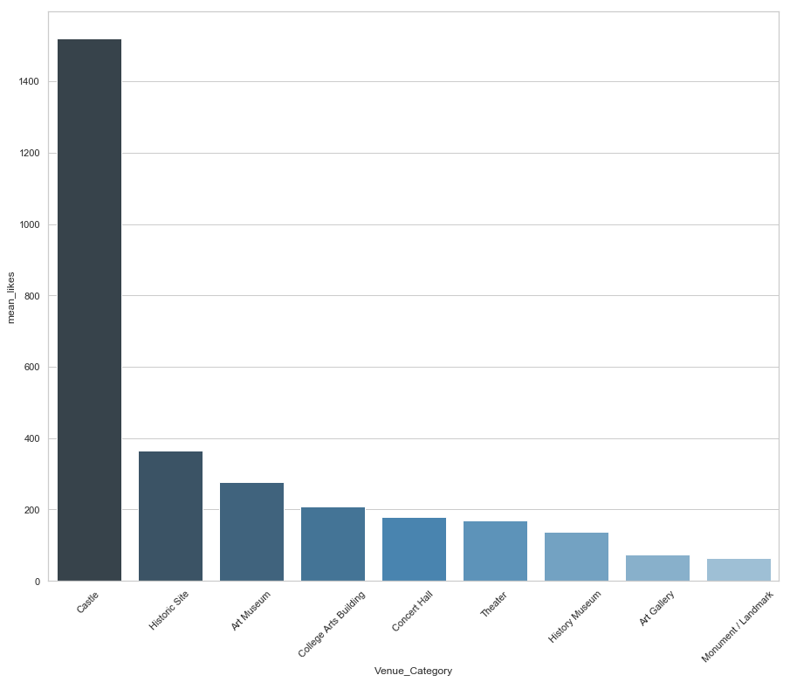
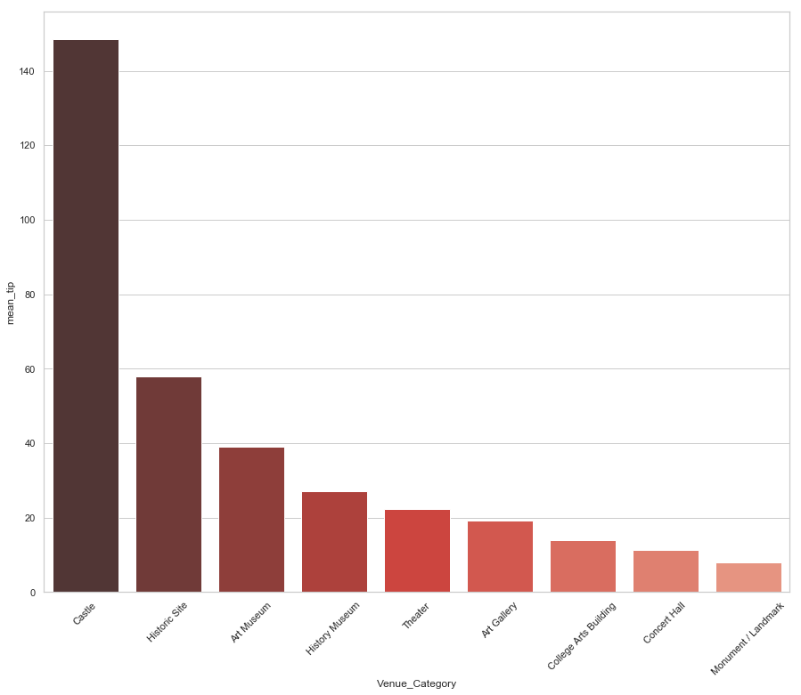
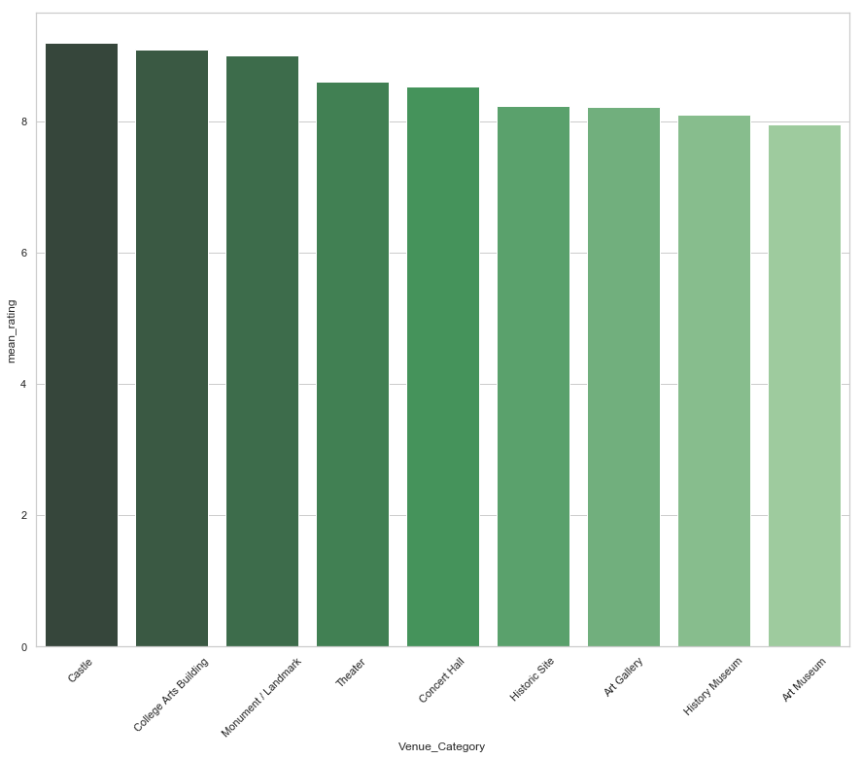
Results I.
Likes, tips and ratings are more or less interconnected
Likes by Types of Cultural Sights:
Tips by Types of Cultural Sights:
Ratings by Types of Cultural Sights:

Slide 7
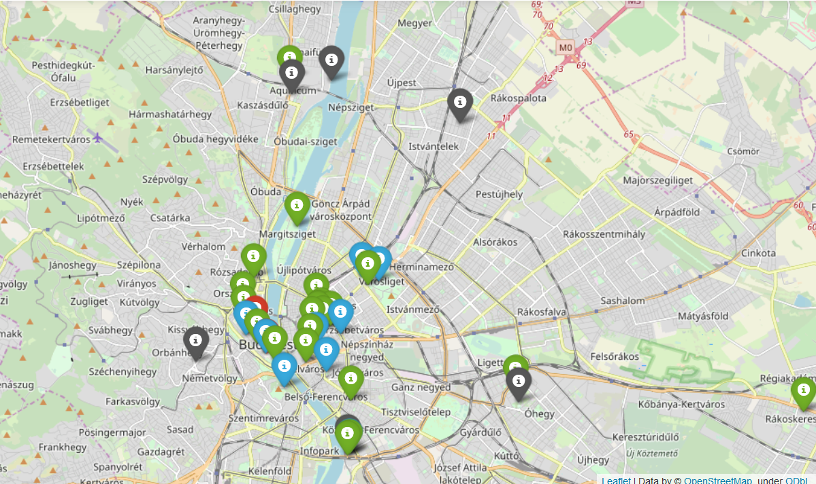
Results II.
Cluster analysis:
Cluster1: Rarely liked places with low recommendation and rating
Cluster2: Frequently liked places with high recommendation and rating
Cluster3: Most frequently liked places with very high recommendation and rating
Cluster4: Less frequently liked places with low number of recommendation but fairly good rating
Marked in map:
less frequently visited places: far from the city centre
places from the other three clusters: condensed close to the centre
some sights from cluster 4: fall far from the city centre

Slide 8
Discussion
Recommendations regarding channelling developmental resources
Considering the volume of visits and recommendationsupkeeping high level of services at cultural sights belongs to Cluster 3 is crucial
Cconcentrating on those areas that are condensed
Public transportation and advertisement should be improved for connecting better distant institutions, places and sights that get little attention
Recommendations regarding future analysis
Adding data from other to balance, contrast and compare the results
Validating that venues belongs to the given neighborhood and clusters
Adding traffic data

Slide 9
Thanks for your attention!

